Slide 1

File Operations

Slide 2
File Concept in Python
We use open () function in Python to open a file in read or write mode. As explained above, open ( ) will return a file object. To return a file object we use open() function along with two arguments, that accepts file name and the mode, whether to read or write. So, the syntax being: open(filename, mode). There are three kinds of mode, that Python provides and how files can be opened:
“ r “, for reading.
“ w “, for writing.
“ a “, for appending.
“ r+ “, for both reading and writing

Slide 3
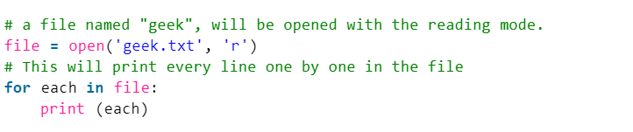
Print each line

Slide 4

Working of read() mode
If you need to extract a string that contains all characters in the file then we can use file.read().

Slide 5
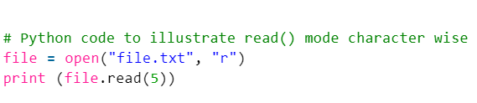
Extract set of characters
Another way to read a file is to call a certain number of characters like in the following code the interpreter will read the first five characters of stored data and return it as a string:

Slide 6
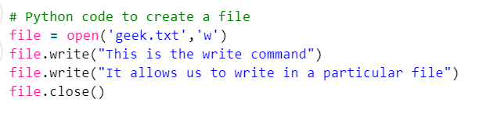
Creating a file using write() mode

Slide 7
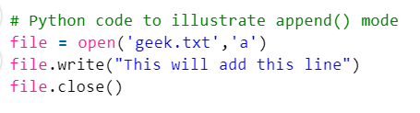
Working of append() mode

Slide 8
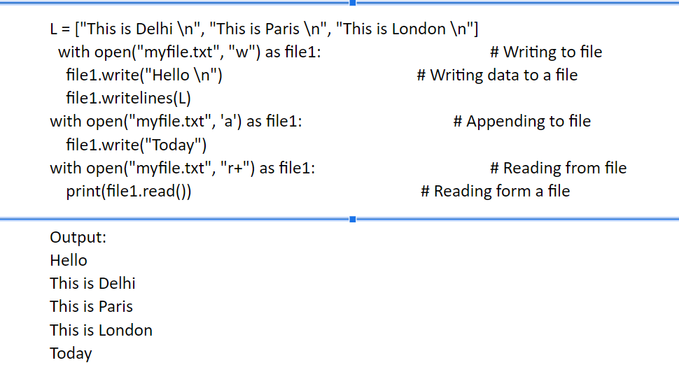
With statement
with statement in Python is used in exception handling to make the code cleaner and much
more readable. It simplifies the management of common resources like file streams. Unlike
the above implementations, there is no need to call file.close() when using with statement.
The with statement itself ensures proper acquisition and release of resources.

Slide 9
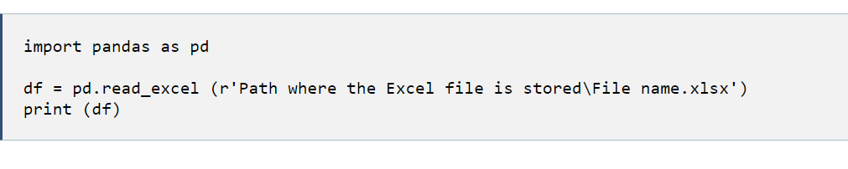
Ms Exel files
You can easily import an Excel file into Python using Pandas. In order to accomplish this goal, you’ll need to use read_excel.

Slide 10
JSON files
json.load(): json.load() accepts file object, parses the JSON data, populates a Python dictionary with the data and returns it back to you.

Slide 11
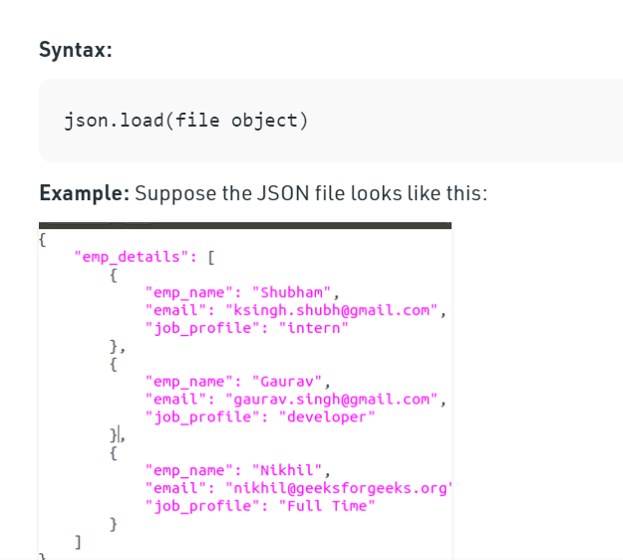

Slide 12
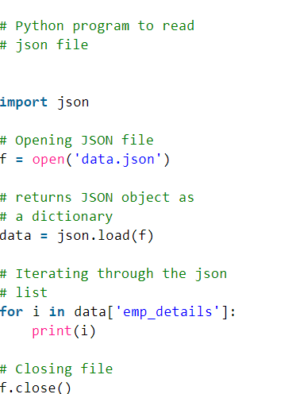
We want to read the content of this file. Below is the implementation.

Slide 13
Reading xml file
from bs4 import BeautifulSoup
# Reading the data inside the xml
# file to a variable under the name
# data
with open('dict.xml', 'r') as f:
data = f.read()
# Passing the stored data inside
# the beautifulsoup parser, storing
# the returned object
Bs_data = BeautifulSoup(data, "xml")

Slide 14
# Finding all instances of tag
# `unique`
b_unique = Bs_data.find_all('unique')
print(b_unique)
# Using find() to extract attributes
# of the first instance of the tag
b_name = Bs_data.find('child', {'name':'Frank'})

Slide 15
print(b_name)
# Extracting the data stored in a
# specific attribute of the
# `child` tag
value = b_name.get('test')
print(value)

Slide 16

CSV files

